Slide 1

REAL
FAKE
Deepfake Detection
Detecting GAN-generated faces with Vision Transformers
Week 1 · Baseline model & evaluation

Slide 2
1
Background & motivation
What is a deepfake?
Synthetic media in which a person's face is generated or swapped by deep learning. Modern GANs such as StyleGAN now produce faces that are essentially indistinguishable from real photographs to the human eye.
Why detection matters
Fake faces fuel misinformation, identity fraud, and reputational harm. As generation gets cheaper and better, automatic detectors are a critical line of defence.
The task
Given a single face image, decide: real or fake. A supervised binary image-classification problem.
The detection gap
~50%
Human accuracy at spotting top-tier GAN faces — barely better than a coin flip.
Goal
A model that beats the human eye — and a pipeline we can extend in later weeks.

Slide 3


2
Project scope & plan
Images only
Faces only
No video / frame extraction this stage
Cropped face images, per mentor's scope
Roadmap
This week
Next
Later
Build a baseline ViT detector; train and test it on a standard dataset.
Adapt the model — harder fakes, cross-dataset tests, robustness.
Generalisation & explainability toward a deployable detector.

Slide 4

3
The dataset
140k Real and Fake Faces
Why this dataset
A balanced, image-only, faces-only benchmark — the standard starting point for deepfake classification.
140,000 images, perfectly balanced 50/50
Pre-split into train / valid / test
Pure images — no video to decode
Widely cited, easy to benchmark against
Source: Kaggle (xhlulu / 140k-real-and-fake-faces)
70,000 REAL
70,000 FAKE
Real human faces from NVIDIA's Flickr-Faces-HQ (FFHQ) set.
GAN-generated faces produced by StyleGAN (the '1M Fake Faces' set).

Slide 5

4
Dataset split & its roles
The data ships in three folders, each with one job: train teaches, validation selects, test judges.
TRAIN
VALIDATION
TEST
~100,000
~20,000
~20,000
50k real + 50k fake
10k real + 10k fake
10k real + 10k fake
Model learns from these — weights are updated every batch.
Checked after each epoch to pick the best model. Never trained on.
Touched once, at the very end — an honest, unbiased score.

Slide 6

5
Approach: why a Vision Transformer
A GAN generates — it does not detect
A ViT is a natural detector
GANs create fake faces; they aren't classifiers. Here the fakes were made by a GAN (StyleGAN), so the detector's job is to learn the artefacts a GAN leaves behind.
We fine-tune an ImageNet-pretrained Vision Transformer as a 2-class (real / fake) classifier. Self-attention captures global texture cues that betray synthetic images.
Detection pipeline
Face image
Pretrained ViT-Base/16
2-class head
Real / Fake + score
Transfer learning: the backbone already knows general image features — we only adapt it to the real-vs-fake decision.

Slide 7

6
Tools & code
Stack
train.py
PyTorch
timm
fine-tunes ViT on train/, validates each
epoch, saves best checkpoint by val acc
→ checkpoints/best_model.pt
deep-learning framework
pretrained ViT models
torchvision
scikit-learn
ImageFolder data loading
metrics & ROC-AUC
matplotlib
Colab · T4 GPU
confusion matrix / ROC plots
training environment
test.py
loads best_model.pt, runs the held-out
test/ split once, reports accuracy /
precision / recall / F1 / AUC + plots
Reproducible: one command trains, one command tests — both run on a free Colab GPU.

Slide 8


7
Training setup
Base model | ViT-Base/16 (ImageNet-pretrained, via timm)
Input size | 224 × 224, ImageNet normalisation
Augmentation | Horizontal flip + mild colour jitter
Optimizer | AdamW, learning rate 2e-5, weight decay 1e-4
Loss | Cross-entropy (2 classes)
Batch / epochs | 32 / 3
Precision | Mixed precision (AMP) on GPU
Model selection | Keep checkpoint with best validation accuracy
Best validation accuracy
99.72%
Reached after 3 epochs of fine-tuning on the full 100k training set (~17 min/epoch on a T4).

Slide 9

8
Test-set results
Held-out test set — 20,000 images the model never saw during training or selection.
99.62%
99.84%
99.41%
99.63%
1.000
Accuracy
Recall (detection)
Precision (fake)
F1 (fake)
ROC-AUC
In plain terms: out of 20,000 test faces the model got all but 75 correct — catching 9,984 of 10,000 fakes while raising only 59 false alarms on real faces.

Slide 10
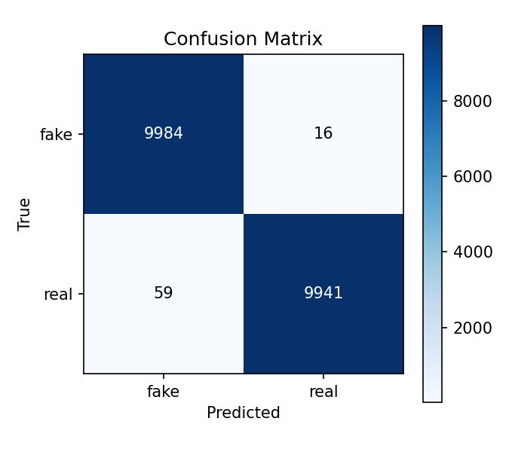
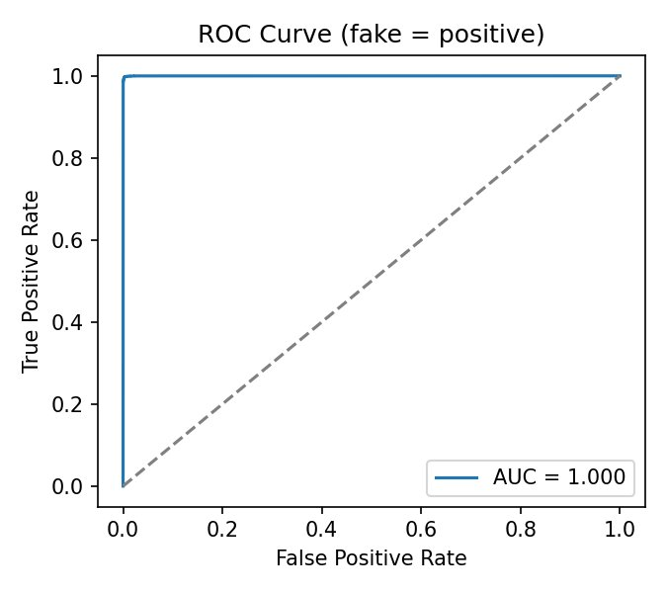
9
Confusion matrix & ROC curve
16 fakes missed · 59 reals falsely flagged
Near-perfect separation (curve hugs the top-left)
Fake is treated as the positive class — recall here is the share of fakes successfully caught.

Slide 11

10
Interpretation & limitations
A ROC-AUC of 1.000 should prompt caution, not just celebration. It signals the benchmark is saturated — not that deepfake detection is solved.
Single generator
Every fake comes from StyleGAN, so the model learned one generator's fingerprint — not 'fakeness' in general.
Curated images
Clean, aligned, high-quality faces. Real-world uploads are compressed, blurred and cropped differently.
Generalisation gap
Models this confident here often drop sharply on fakes from other sources (diffusion, face-swaps, FaceForensics++).

Slide 12

11
Next steps
Cross-dataset testing
Newer fake types
1
2
Evaluate on FaceForensics++, Celeb-DF, DFDC to measure true generalisation.
Add diffusion-generated faces and face-swaps, not just one GAN.
Robustness
GAN fingerprints
3
4
Test under JPEG compression, blur and resizing (social-media conditions).
Add frequency-domain (FFT/DCT) features that expose generator artefacts.
Explainability
Stronger baselines
5
6
Attention / Grad-CAM maps to see what the model focuses on.
Compare ViT against CNNs and ensembles.

Slide 13
Week 1 — summary
Built and validated a working deepfake-detection baseline end to end.
99.62%
99.84%
1.000
Test accuracy
Fakes caught
ROC-AUC
Delivered: a standard dataset, a fine-tuned ViT classifier, a reproducible train/test pipeline, and a full evaluation.
Next: push the model past a single generator — cross-dataset, harder fakes, and robustness.
Thank you

